Slide 1
Karamoja sub-region crop yield visualization and analysis for 2017
Project by Andrew B. Sanaa

Slide 2
Outline
Project brief and scope
Data exploration and visualization
Thank You
Project objectives

Slide 3
Project brief and scope
Karamoja is semi-arid and suffers from among other things frequent famine, malnutrition occasioned by persistent poor harvests as a result of droughts, animal deaths, cattle theft and poor farming practices.
This study aims to provide a visual representation of how the crops (maize and sorghum) performed in 2017 so as to support the decision making and development of targeted interventions to enhance food security.

Slide 4
Project objectives
To provide a visual representation of how the maize and sorghum grown in the region performed in 2017.
To visualize the correlation between the crop yield and the district population.
To visualize the correlation between the crop yield and crop area per sub-county.

Slide 5
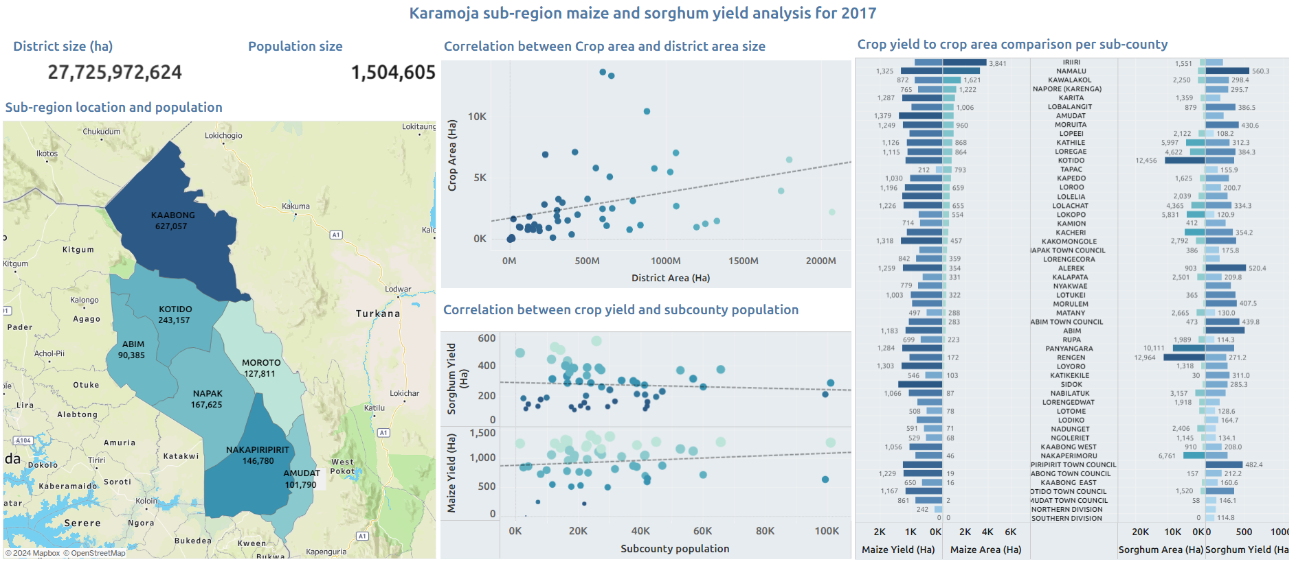
Data exploration and visualization

Slide 6
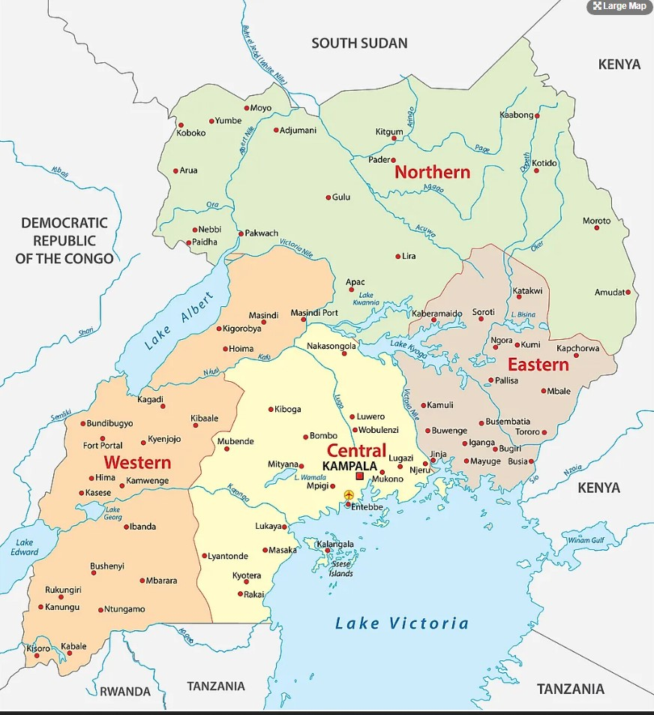
The END
Thank you

